Slide 1


Slide 2


Slide 3


Slide 4
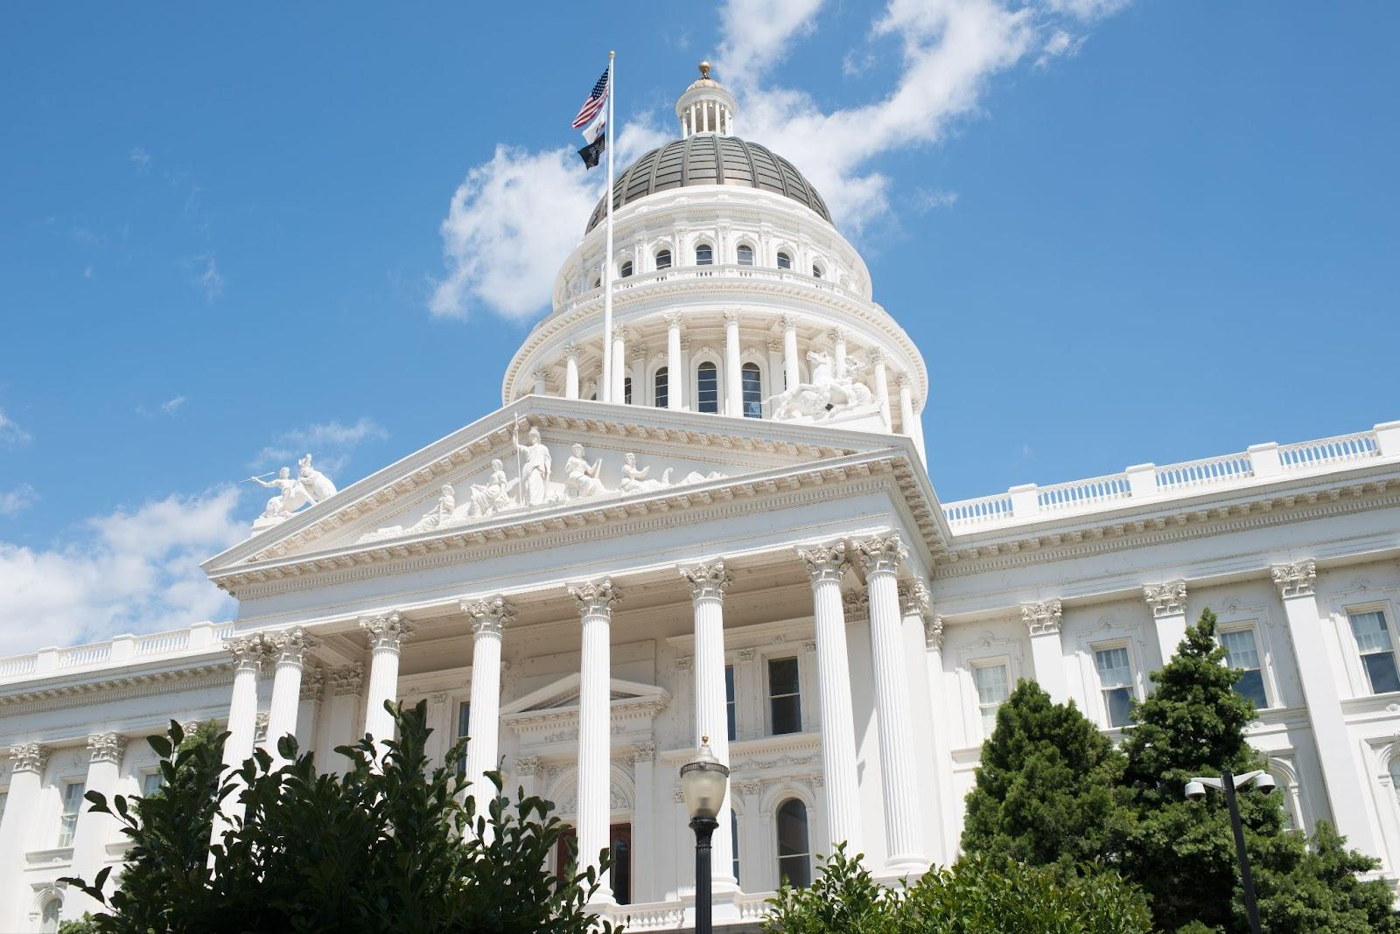

Welcome!

Slide 5
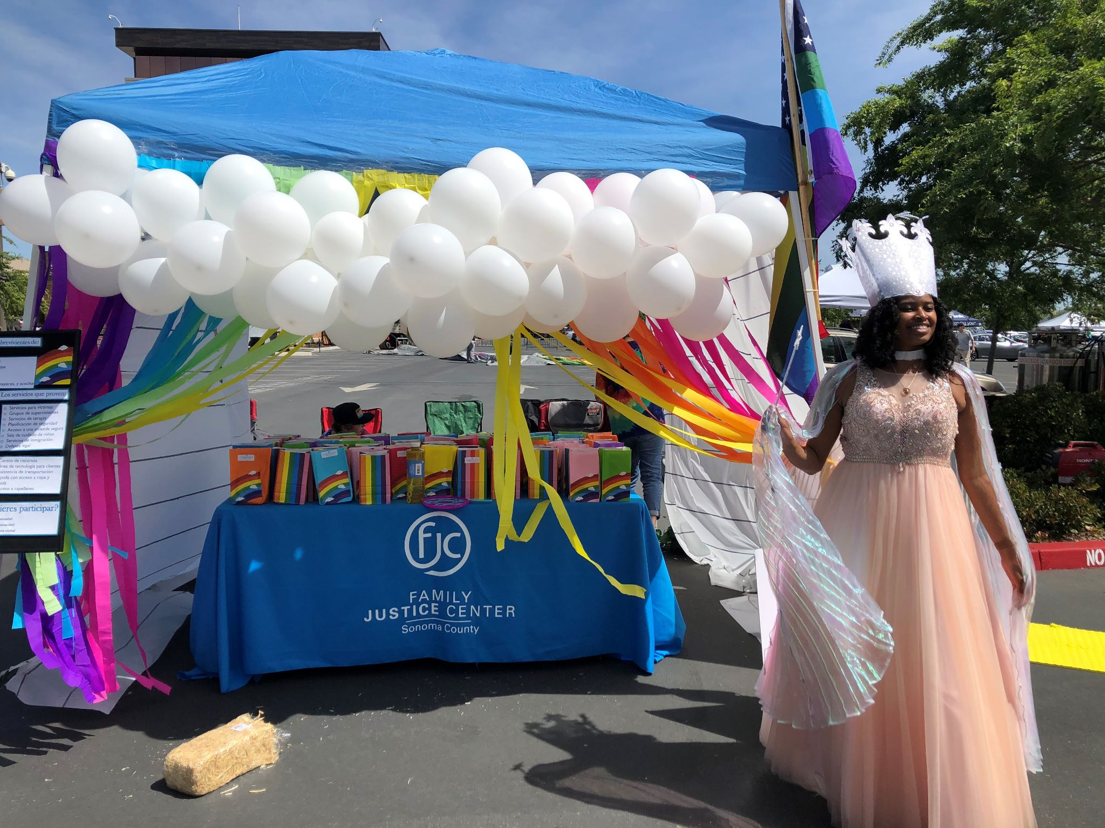
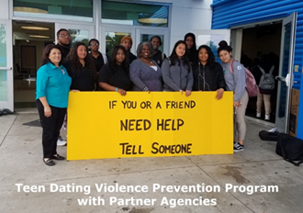
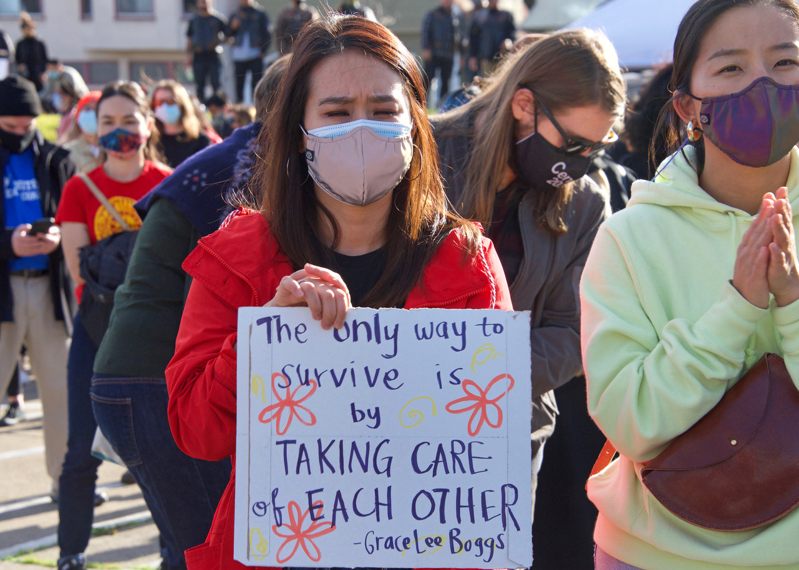
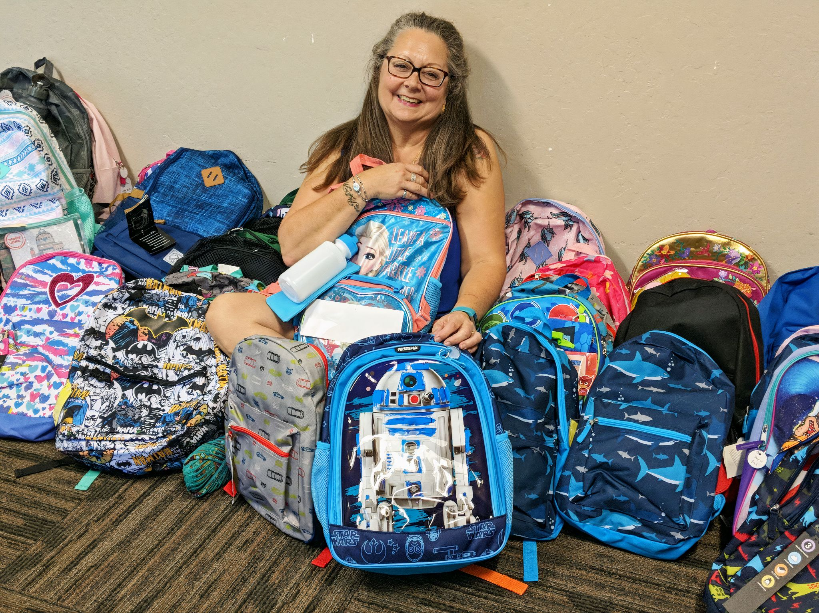
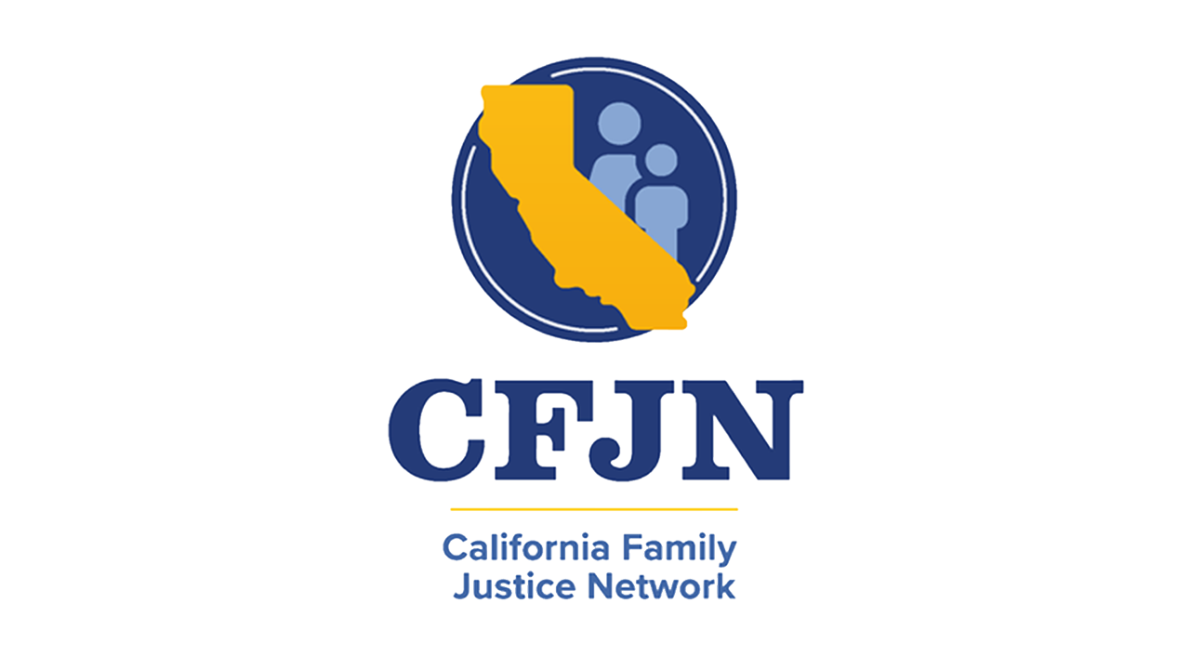
The California Family Justice Network
WELCOMES YOU TO VIRTUAL ADVOCACY DAY 2023!

Slide 6
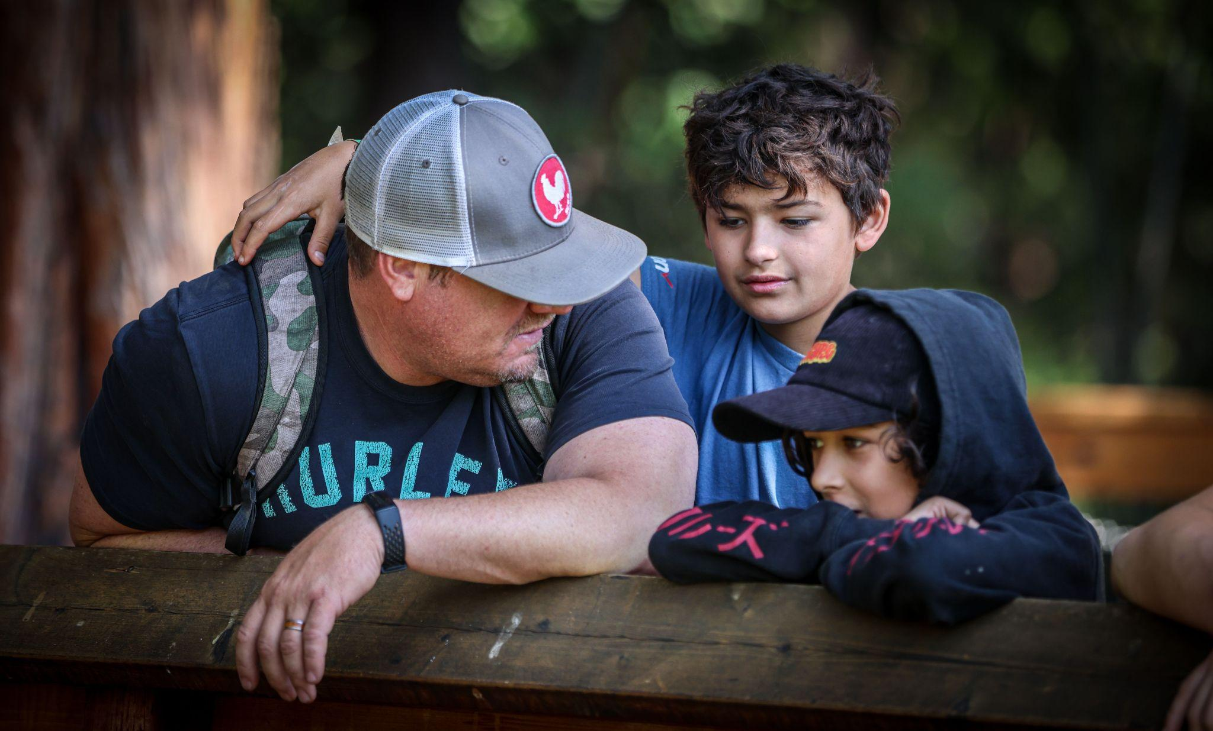
Hope Lives Here

Slide 7
The California Family Justice Network
Advocates for the needs of victims of domestic and sexual violence, human trafficking, elder and child abuse in California with a focus on victim-centered collaboration, as practiced by its 25 member
Family Justice Centers.
#CFJNAdvocacyDay

Slide 8
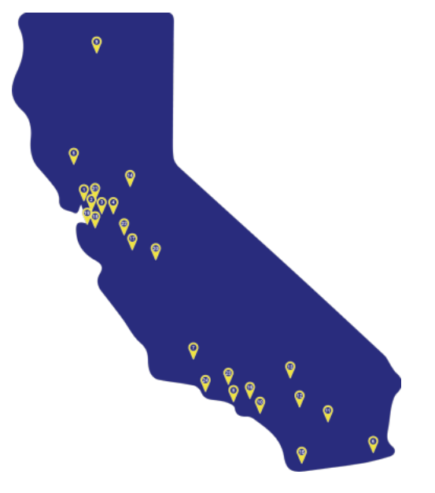
The California Family Justice Network
California is the first and only state in the US to have a Family Justice Center Network.
CFJN represents 26 FJCs throughout California serving over 70,000 victims of interpersonal violence each year.

Slide 9

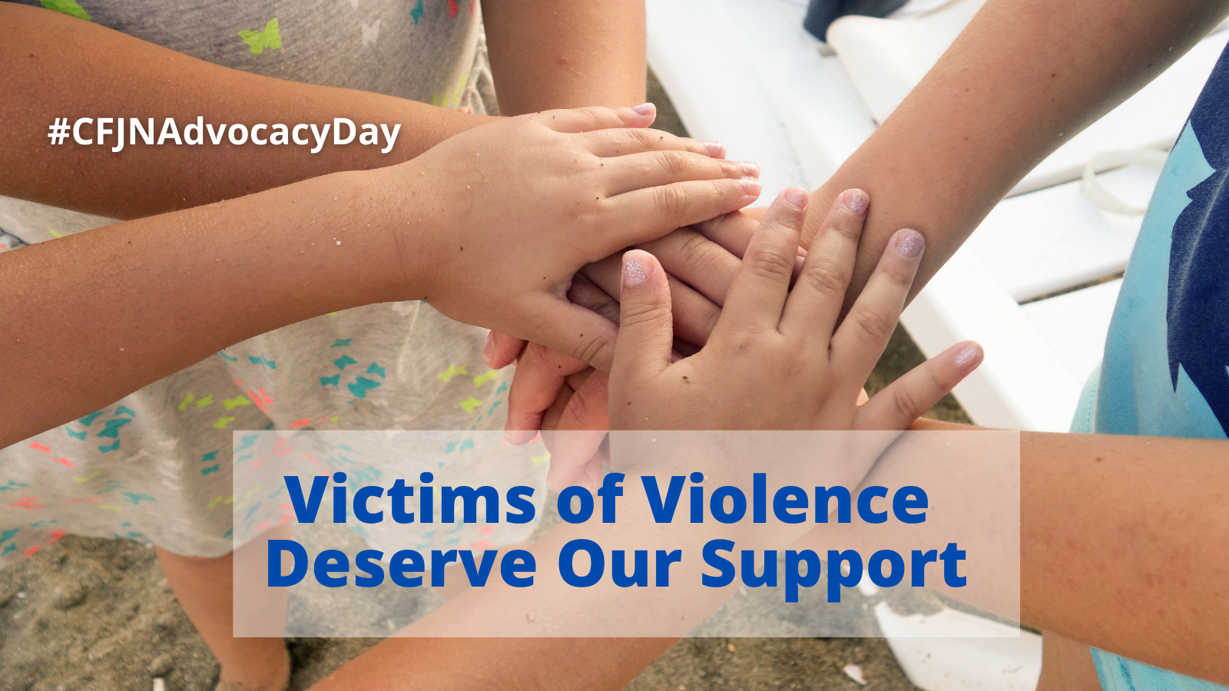
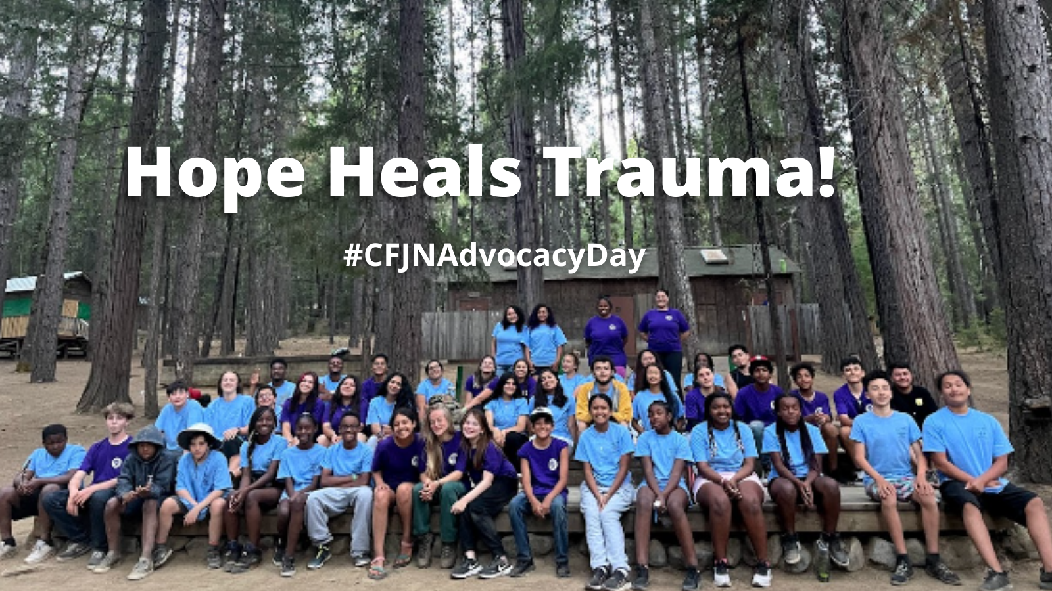
Our Vision
Families Heal and Thrive

Slide 10

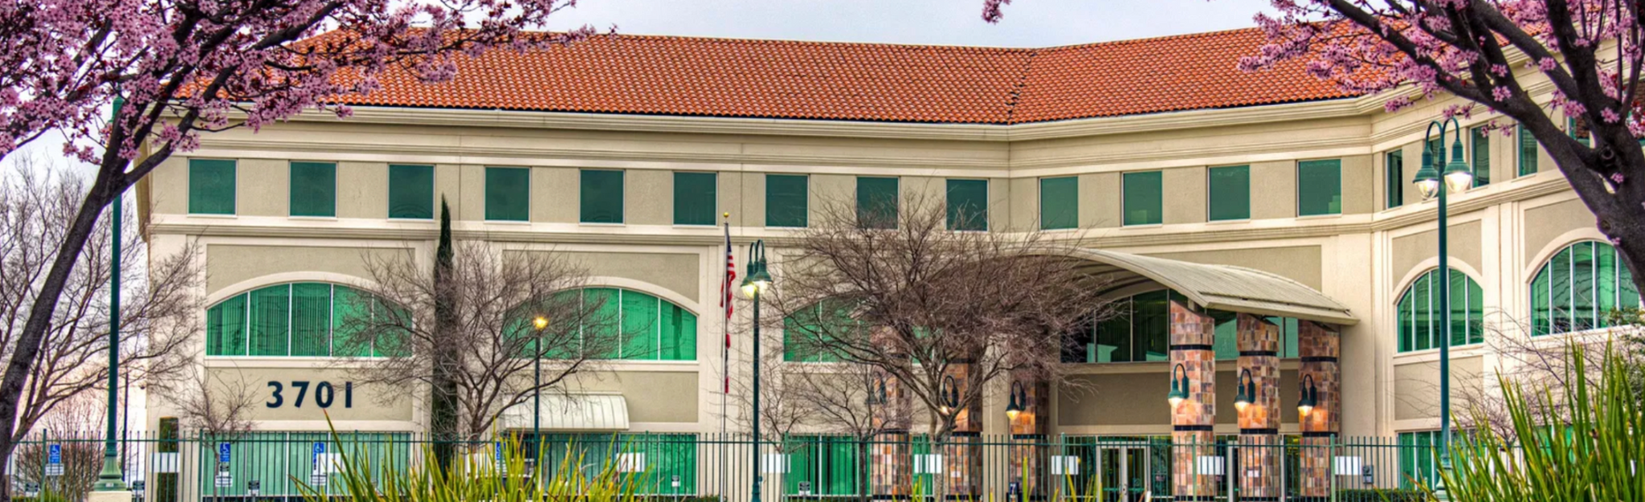
Sacramento

Slide 11
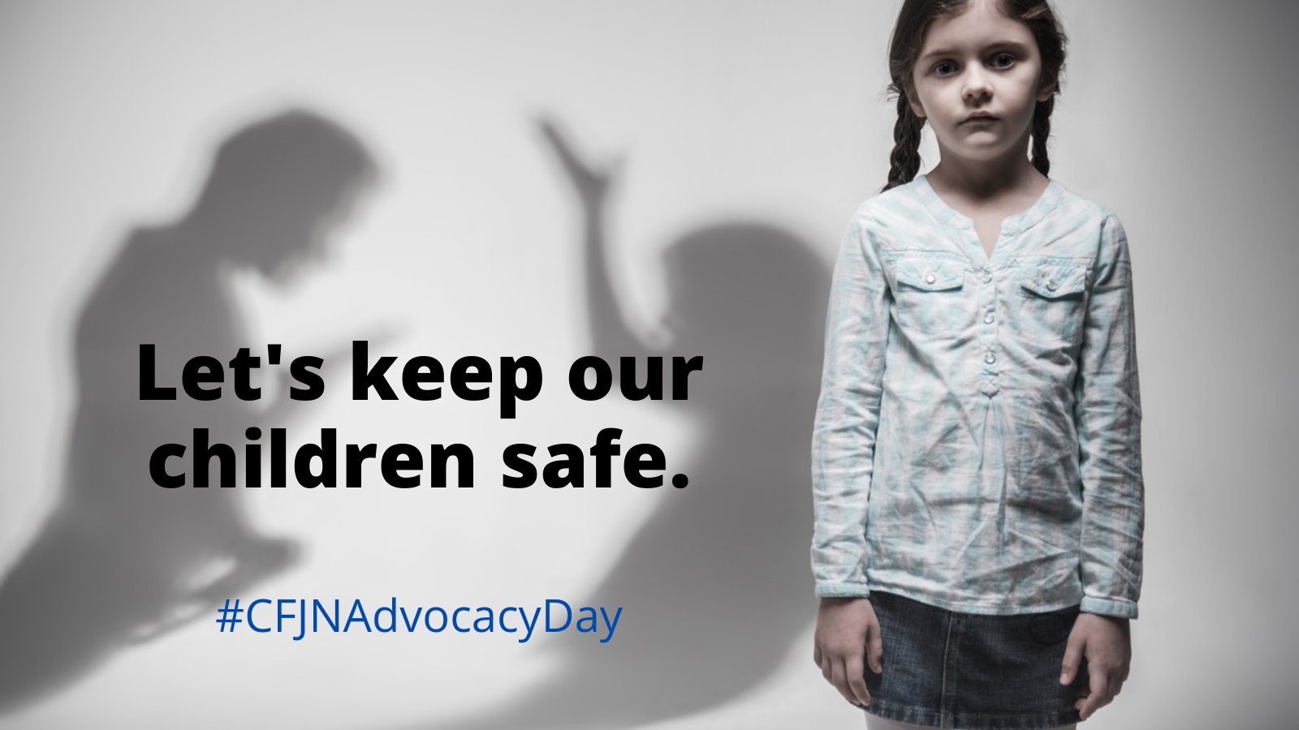
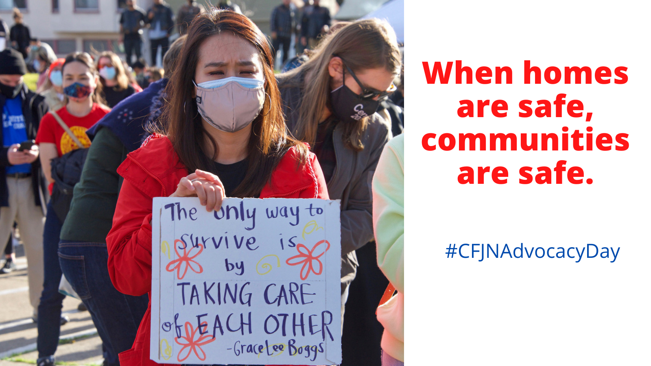
Our Work
Increase Hope, Resiliency, Safety
and Well-Being in the lives
of children and adults.

Slide 12
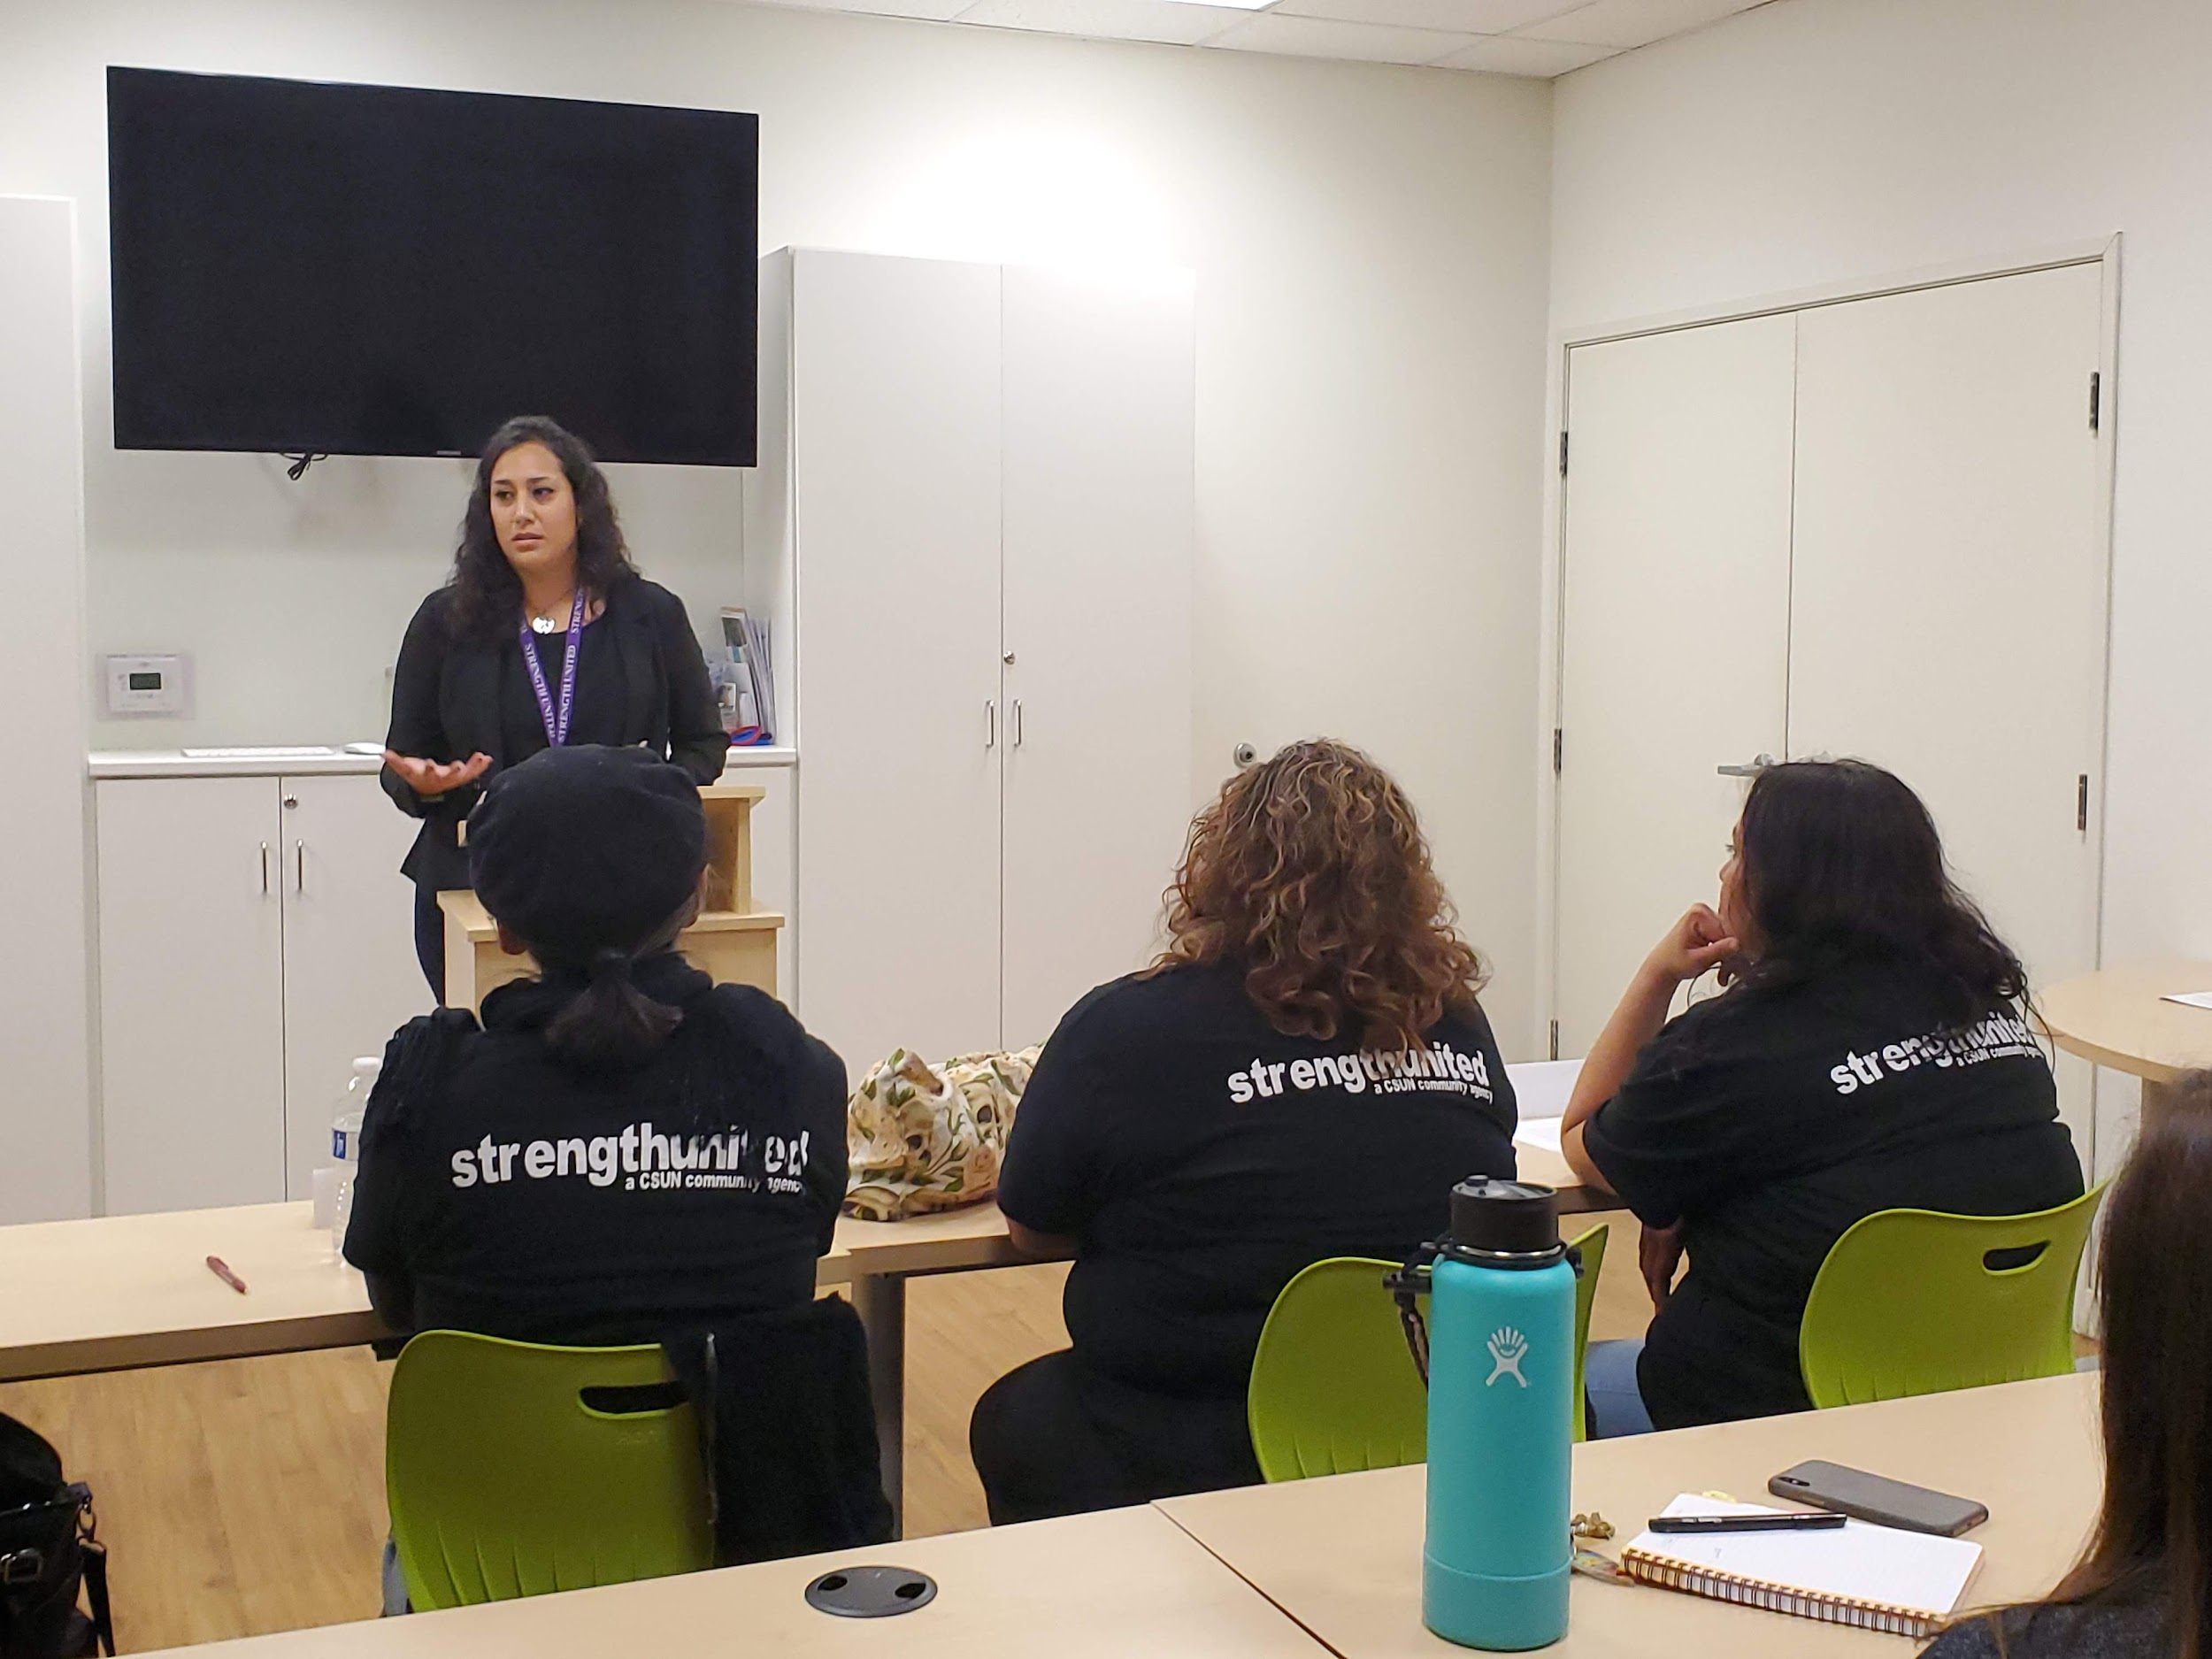

Strength United FJC

Slide 13
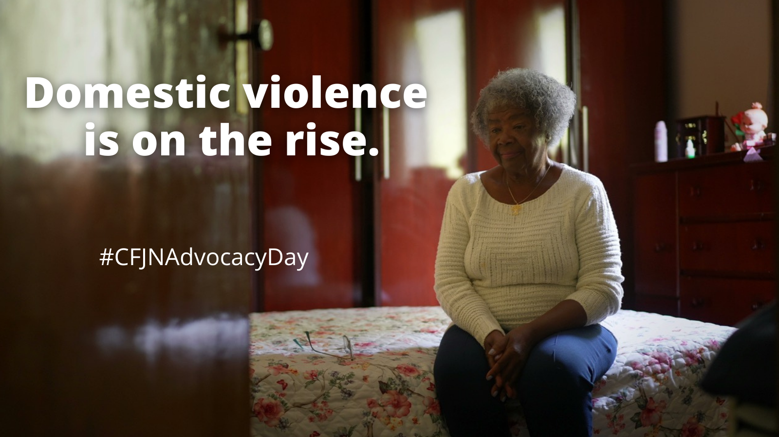
Did You Know?
Since the onset of COVID-19,
spikes in demand for FJC services have risen up to 75% in some jurisdictions.

Slide 14
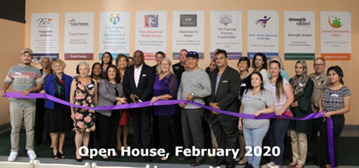
New Star FJC

Slide 15
Did You Know?
20% of the victims served by FJCs in California
are children.

Slide 16
Our Vision
Children Are Protected

Slide 18

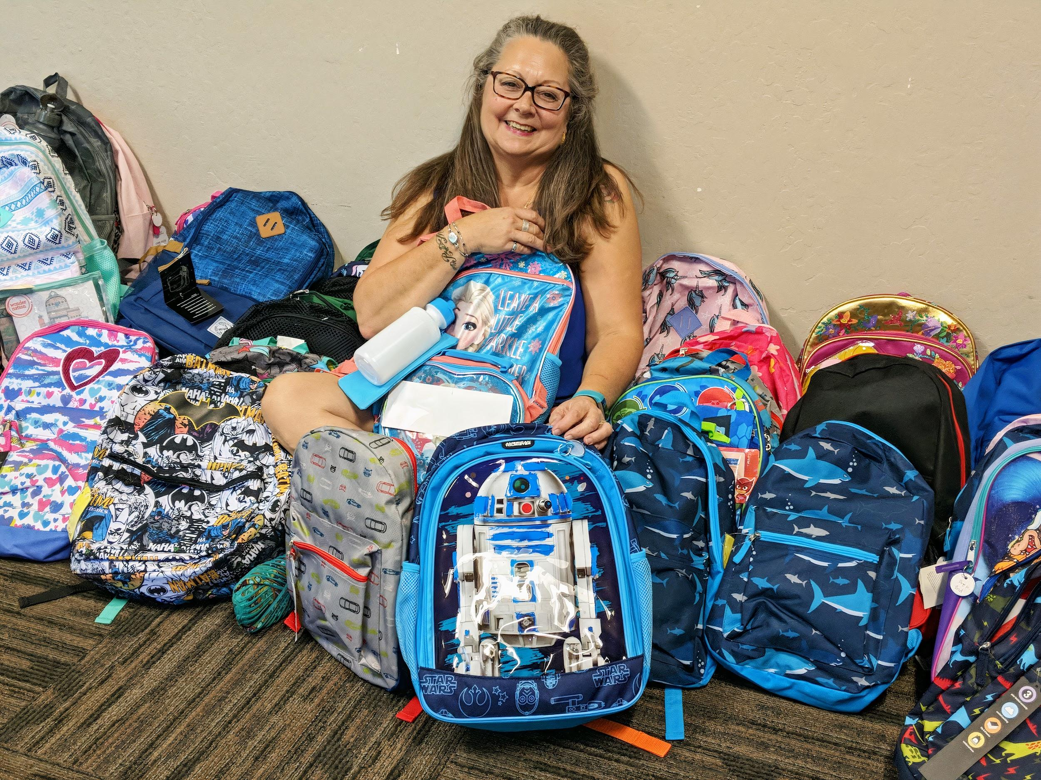
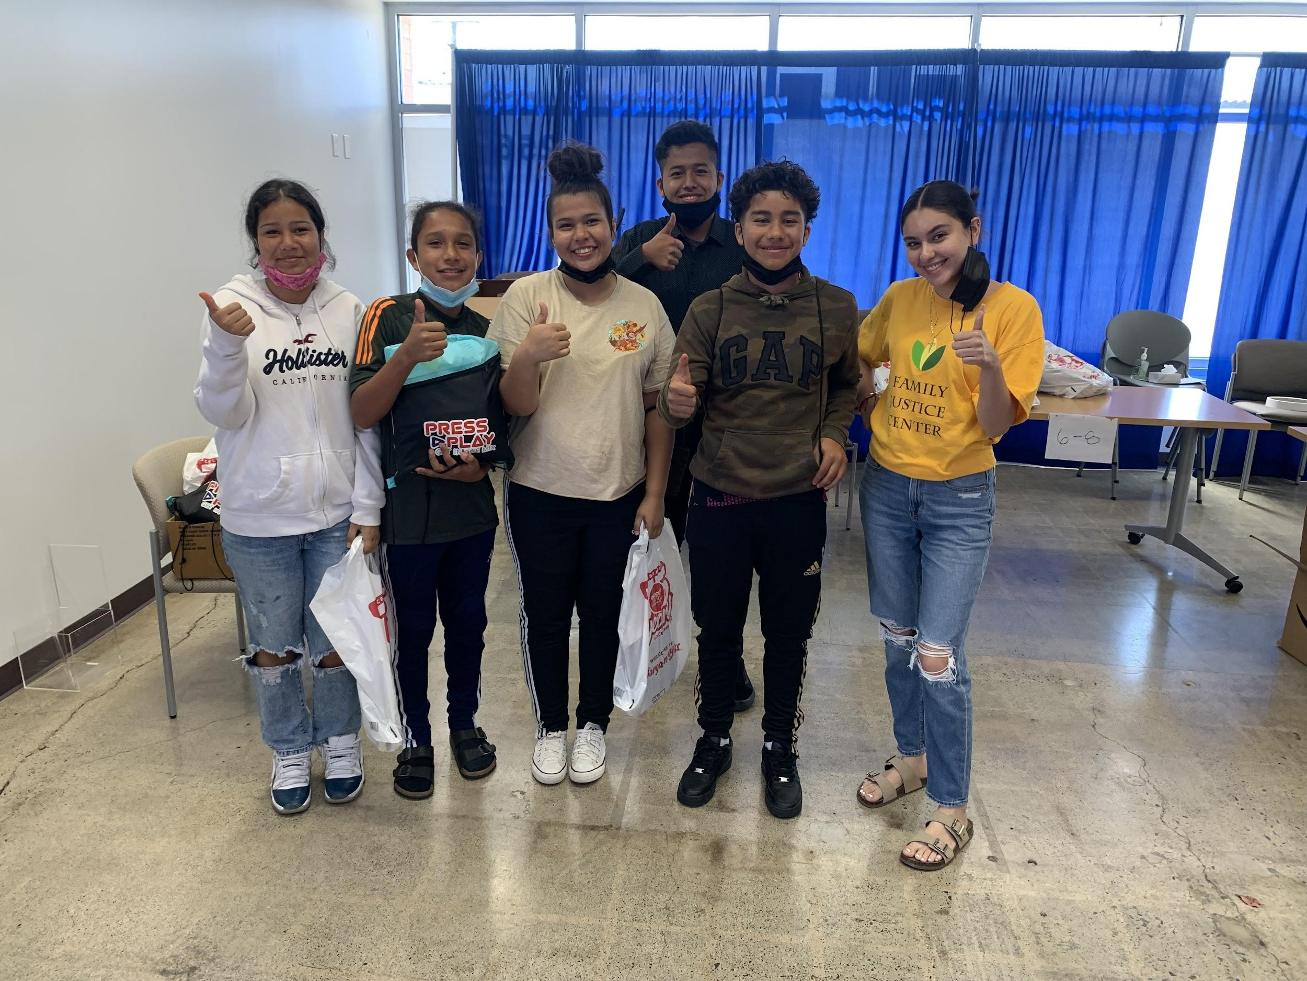
Contra Costa FJC

Slide 19
Survivor’s Share Their Appreciation
for Family Justice Centers
“I appreciated the attention and now I don’t feel trapped.
I know where to go and what to do”
“They have been so helpful at a very scary time in my life. I’ve contact them 20+ times in 2-3 days and they are always kind and so helpful.”
“I felt safe here and not judged for being here"

Slide 20
Our Work
Find Pathways To Hope & Healing

Slide 21

Monarch FJC

Slide 23
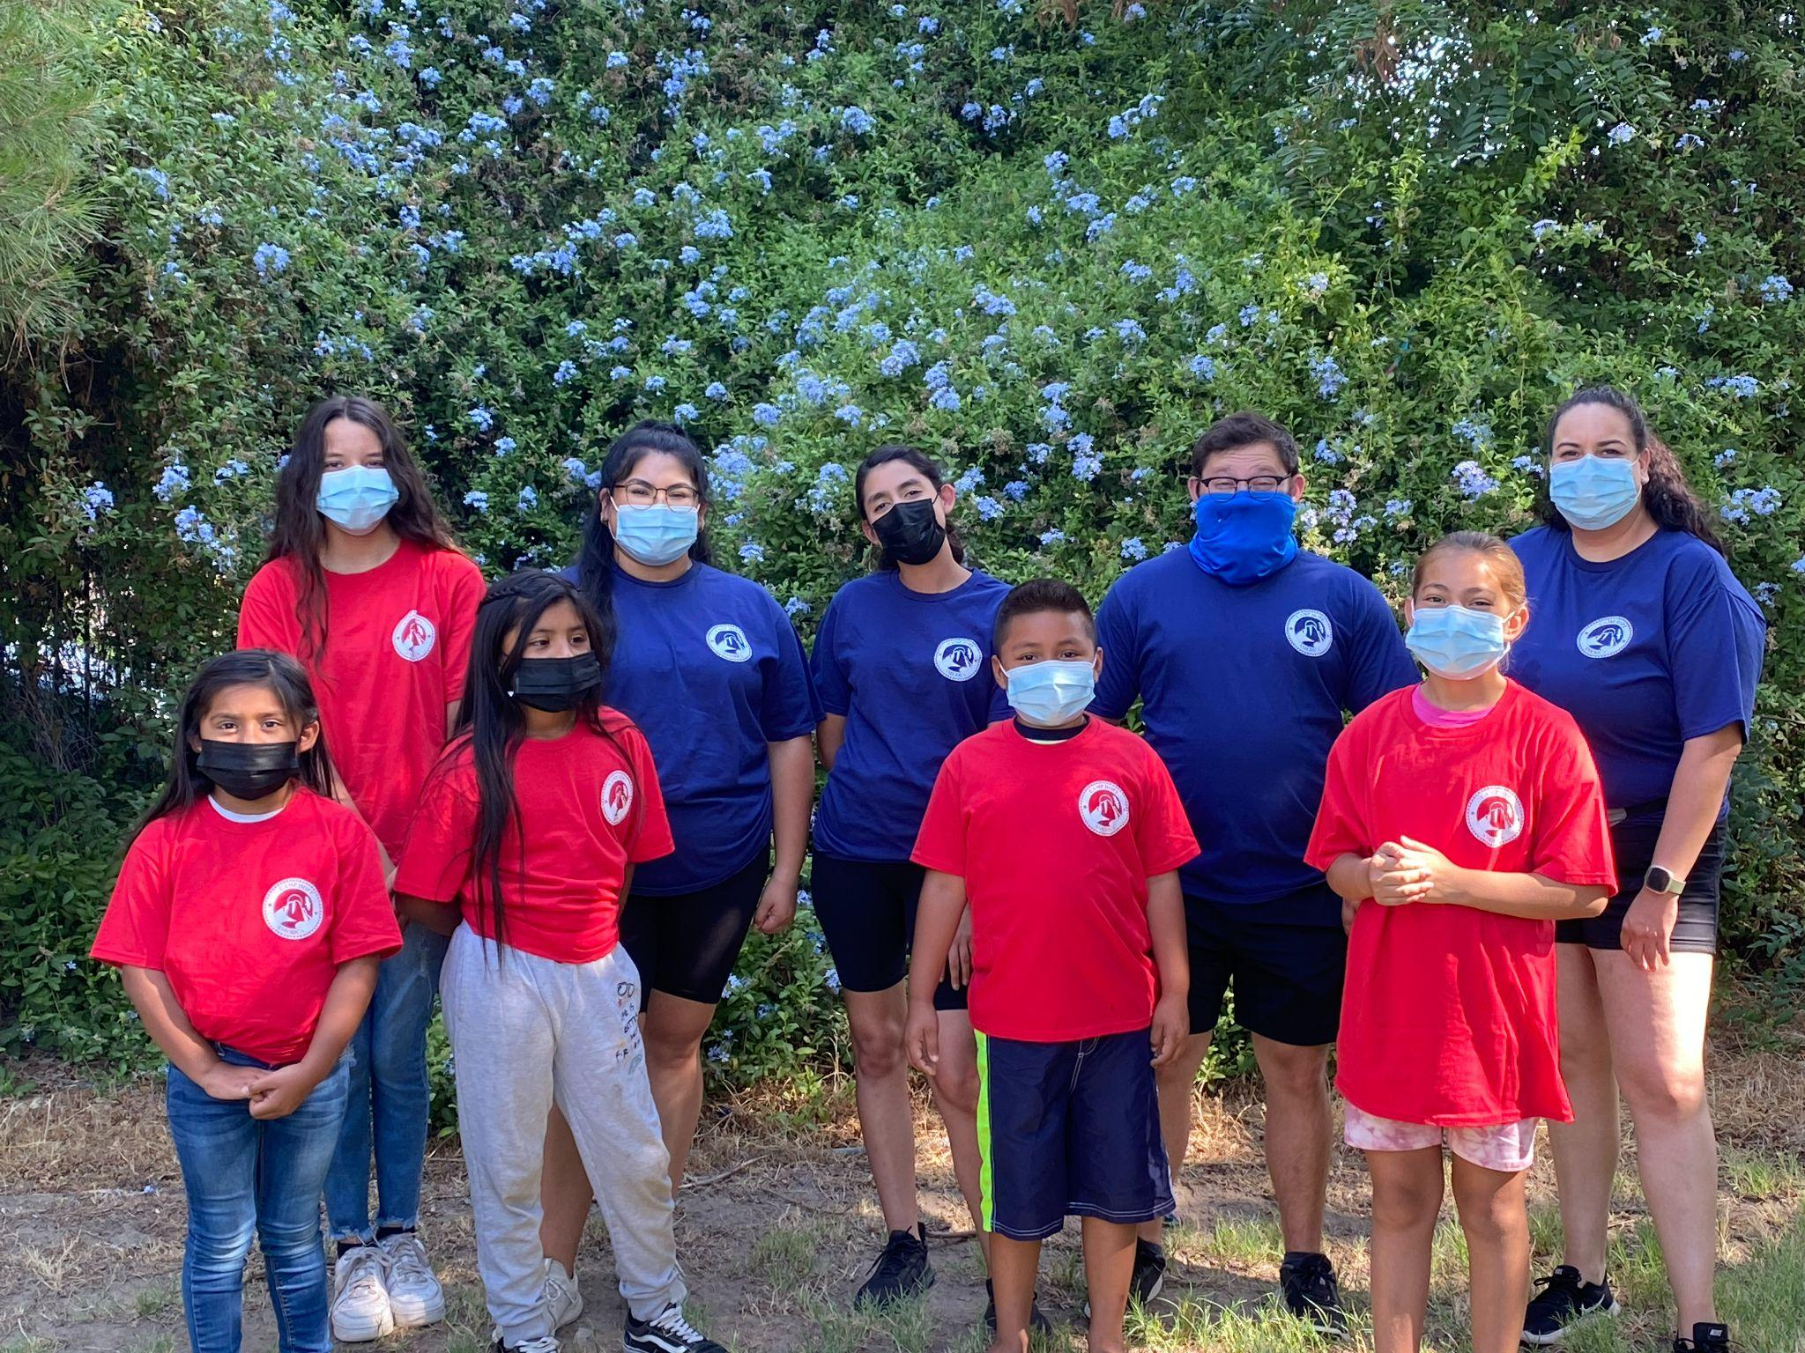
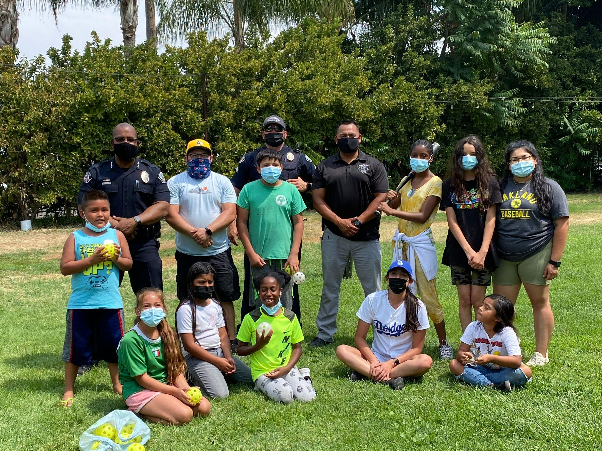

Stanislaus FJC

Slide 24
Did You Know?
84% of identified suspects for female homicides in CA were friends, acquaintances, family members or relatives of the women killed. Only 16% of suspects in the killing of women were strangers (source: CA Department of Justice)

Slide 25
Our Vision
Women have access to safe shelter and
the supports they need to regain
independence and thrive.

Slide 26
Our Work
Enforce Restraining Orders that
Require Gun Confiscation

Slide 27

San Joaquin FJC

Slide 28
Did You Know?
On a typical day, national domestic violence hotline staff receive an average of more than
14 contacts per minute
(via call, text, chat and email).

Slide 29
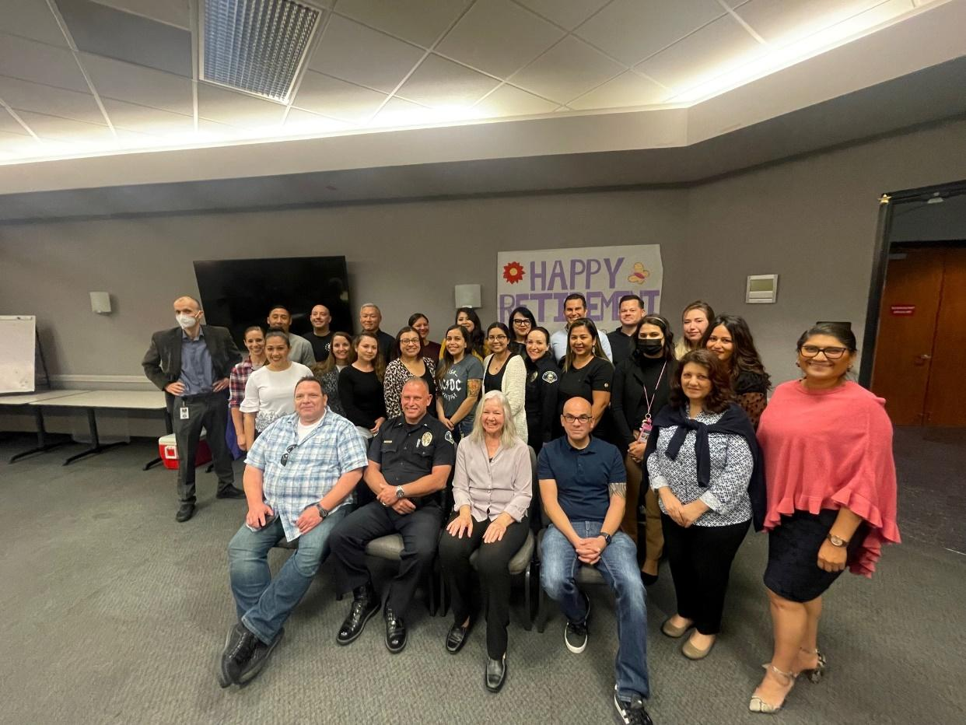
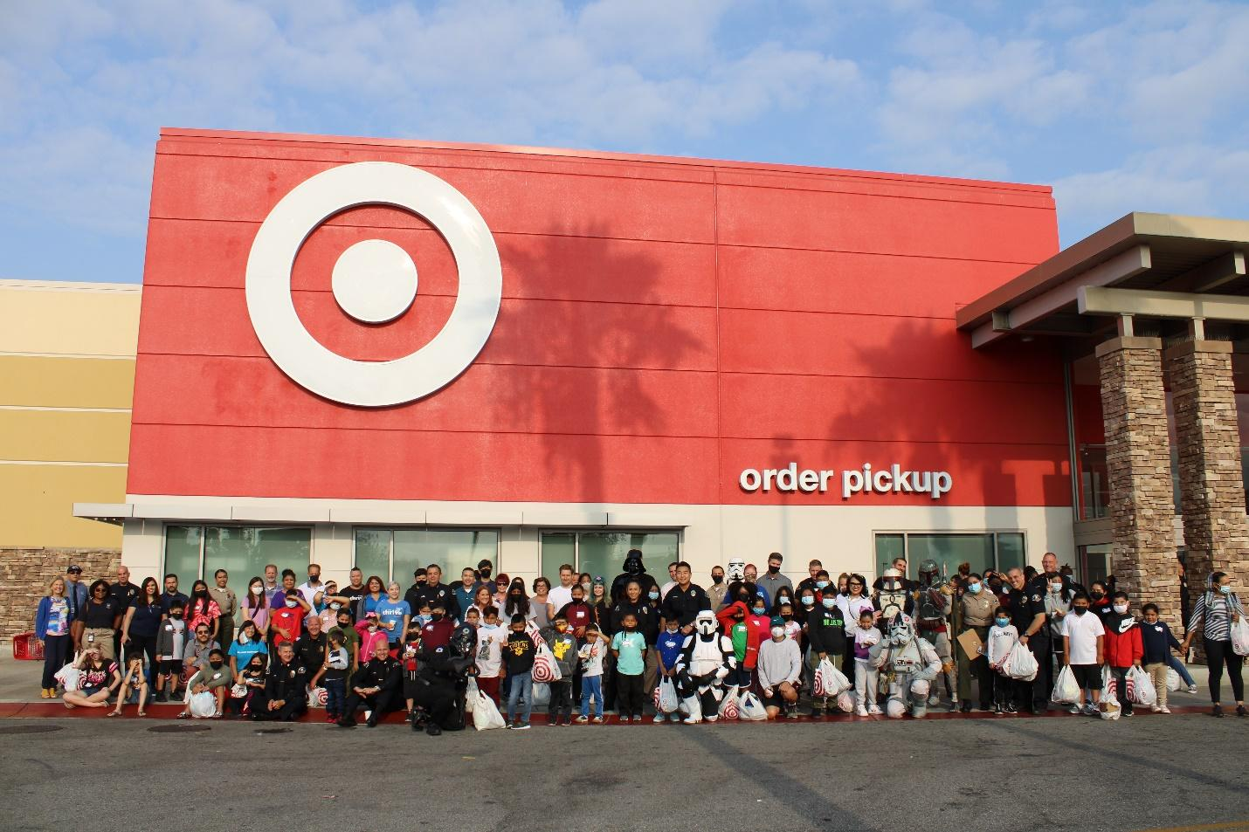
Orange County FJC

Slide 30
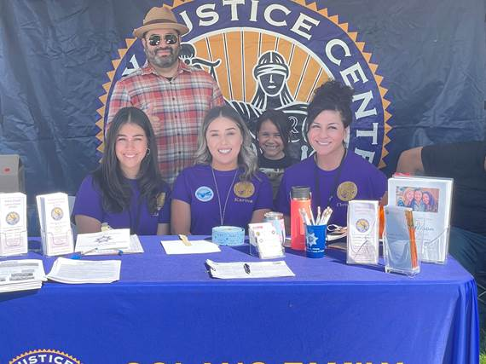

Solano FJC

Slide 31
Our Vision
All The Needs of Victims
Are Met

Slide 32
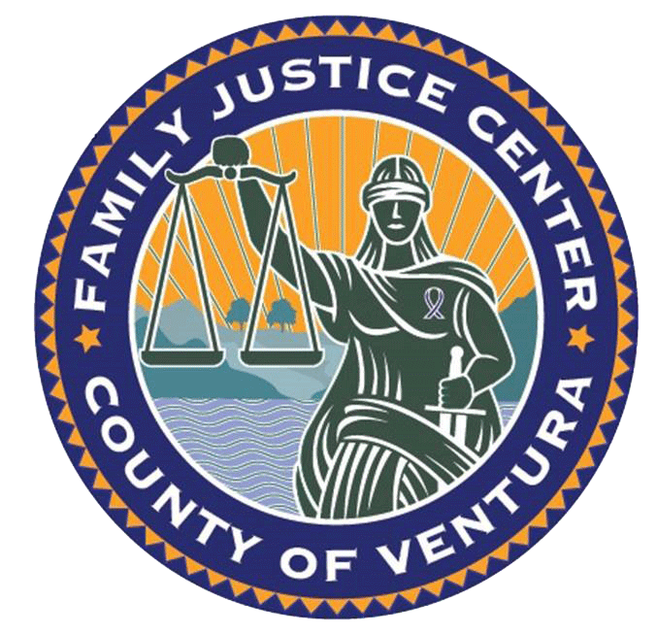
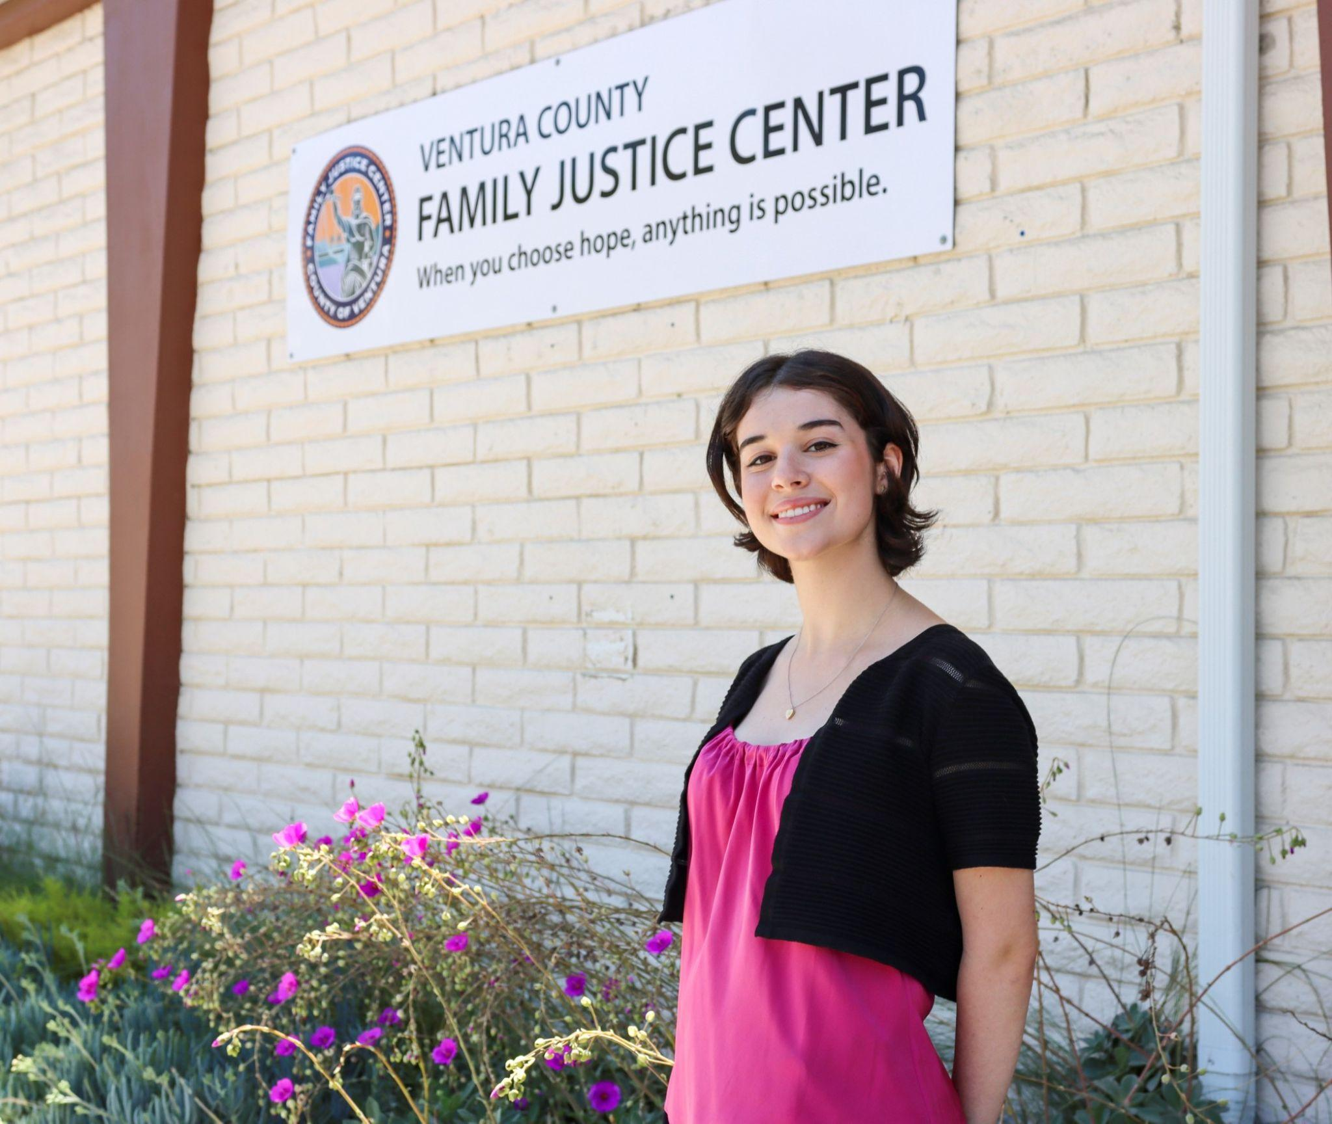
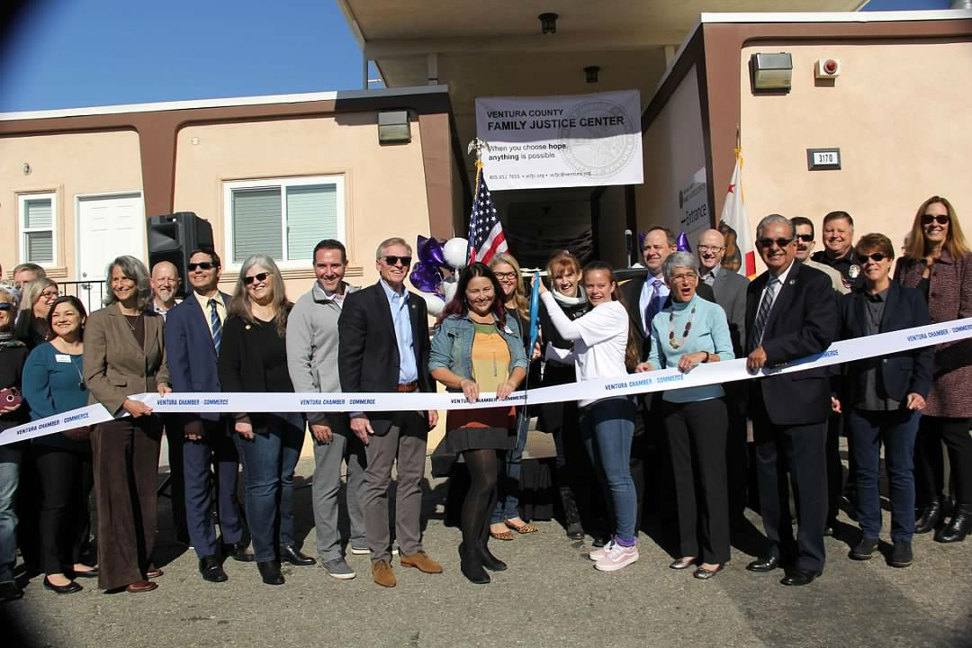
Ventura County FJC

Slide 33
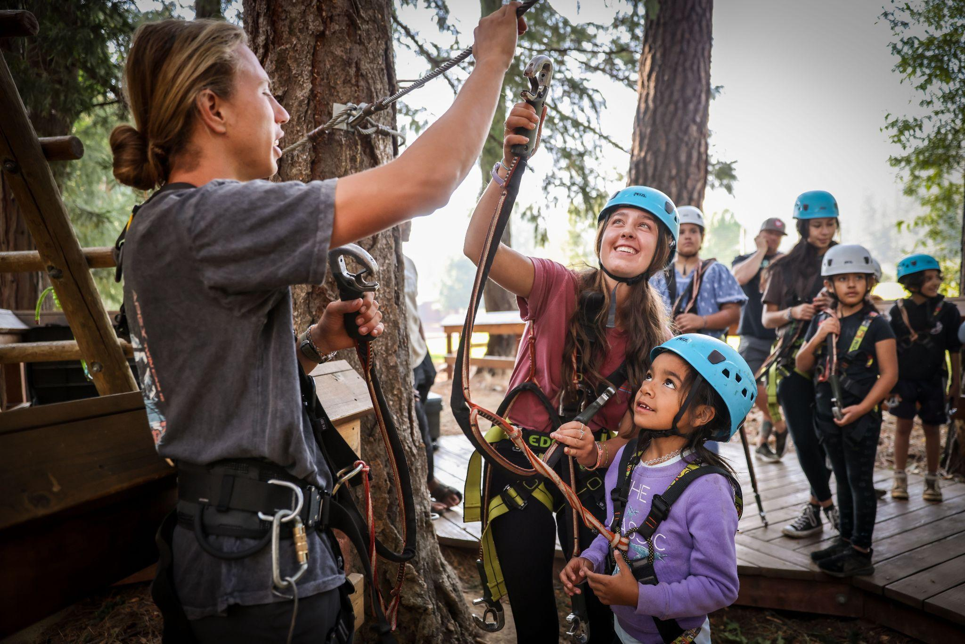
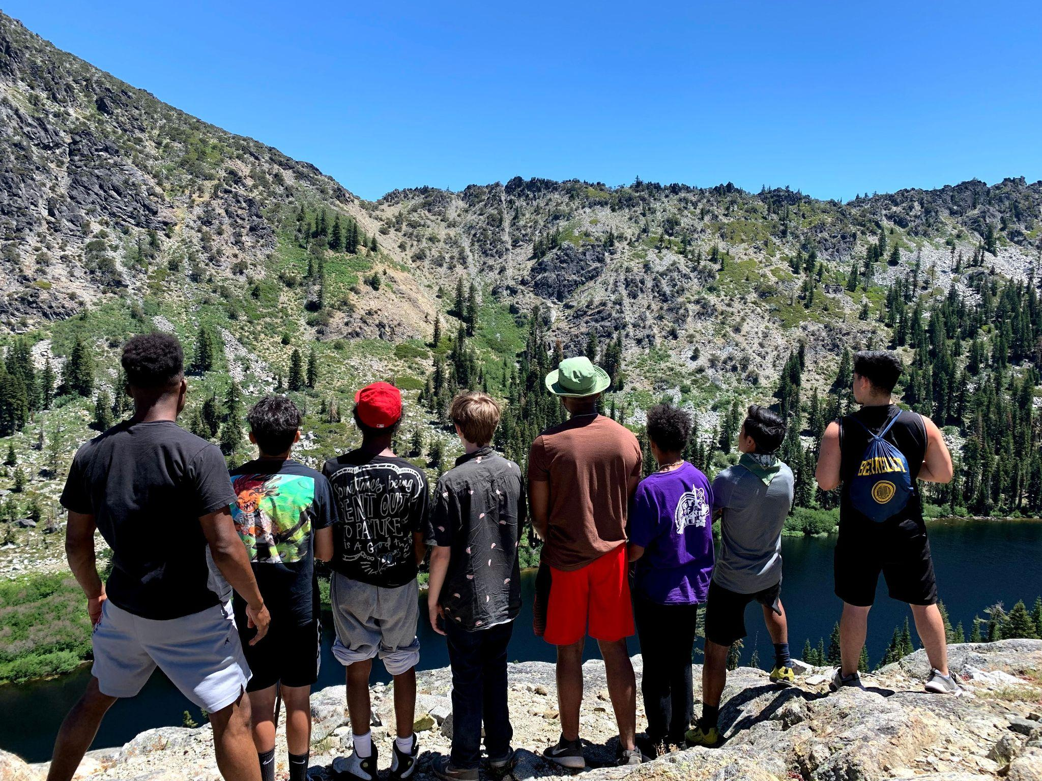

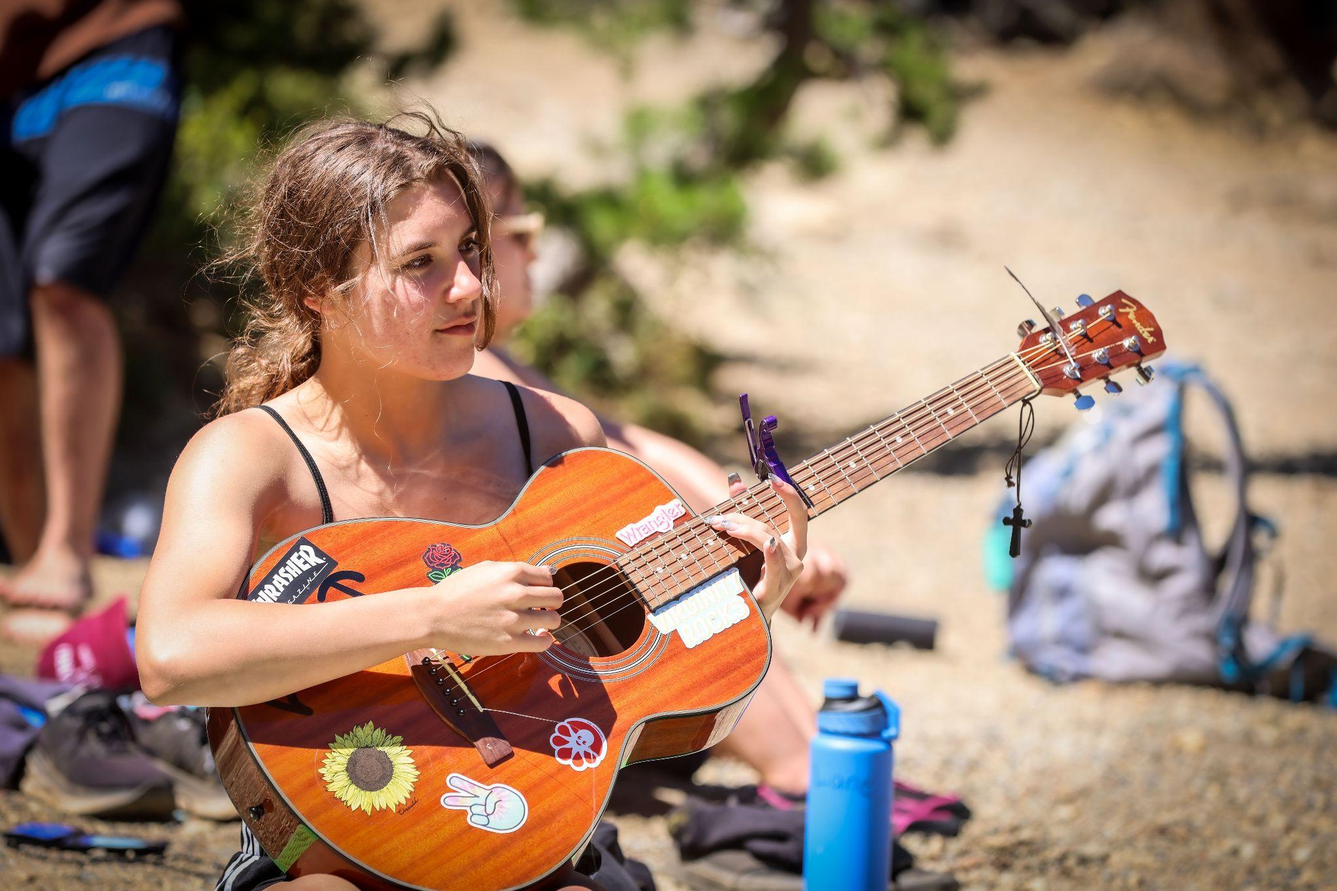
Hope Lives Here

Slide 34
Did You Know?
Recent research points to domestic violence as a precipitating factor for over
68% of mass shootings.

Slide 35

One Safe Place FJC

Slide 36
Our Work
Strengthen Coordinated Response Among Government Agencies and Community Partners

Slide 38
Did You Know?
40% of CA women experience physical intimate partner violence (CPEDV)
Only 14% of crime victims felt “very supported” by the criminal justice system according to a statewide survey of CA victims views on safety and justice conducted by CA Crime Survivors Speak.

Slide 39


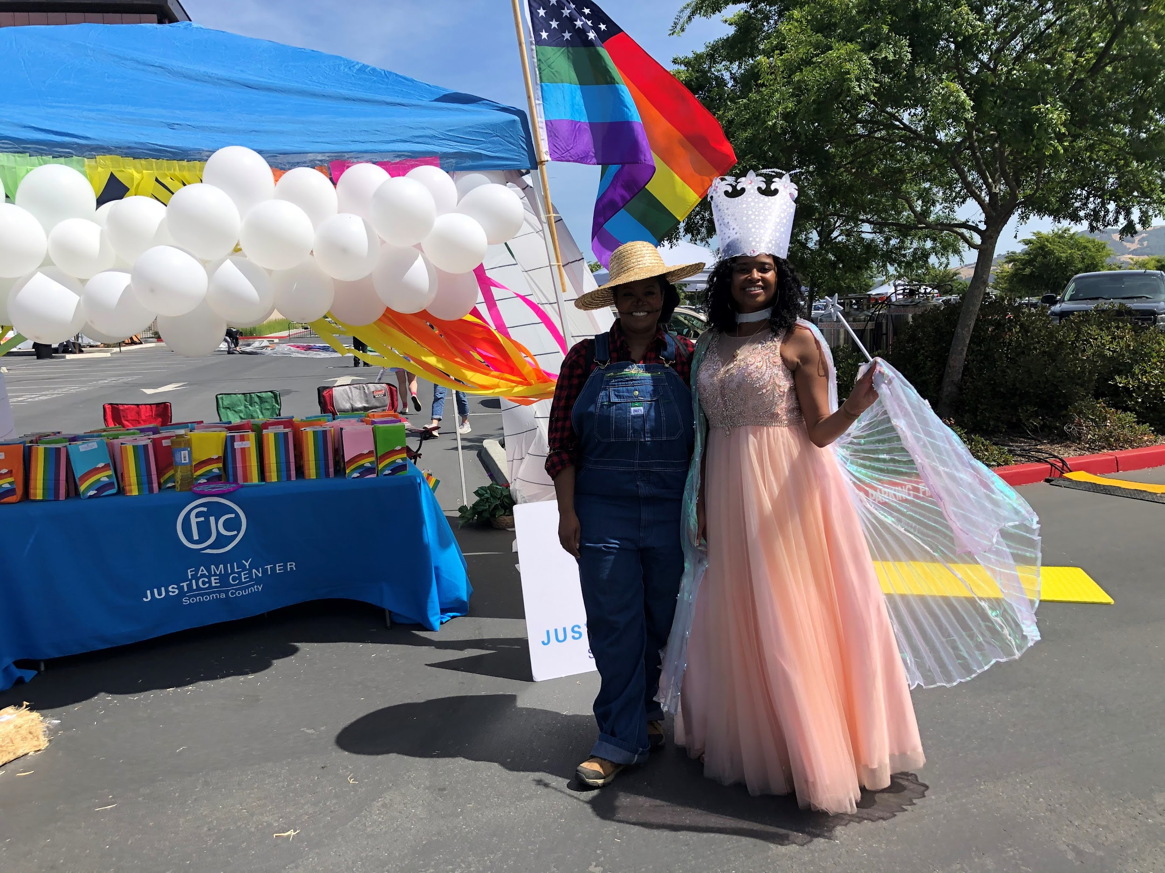
Sonoma FJC

Slide 40
Our Work
“We are meeting clients where they are physically, virtually, emotionally, rather than expecting families to navigate complex systems, which often act as barriers to services.” – Strength United

Slide 41

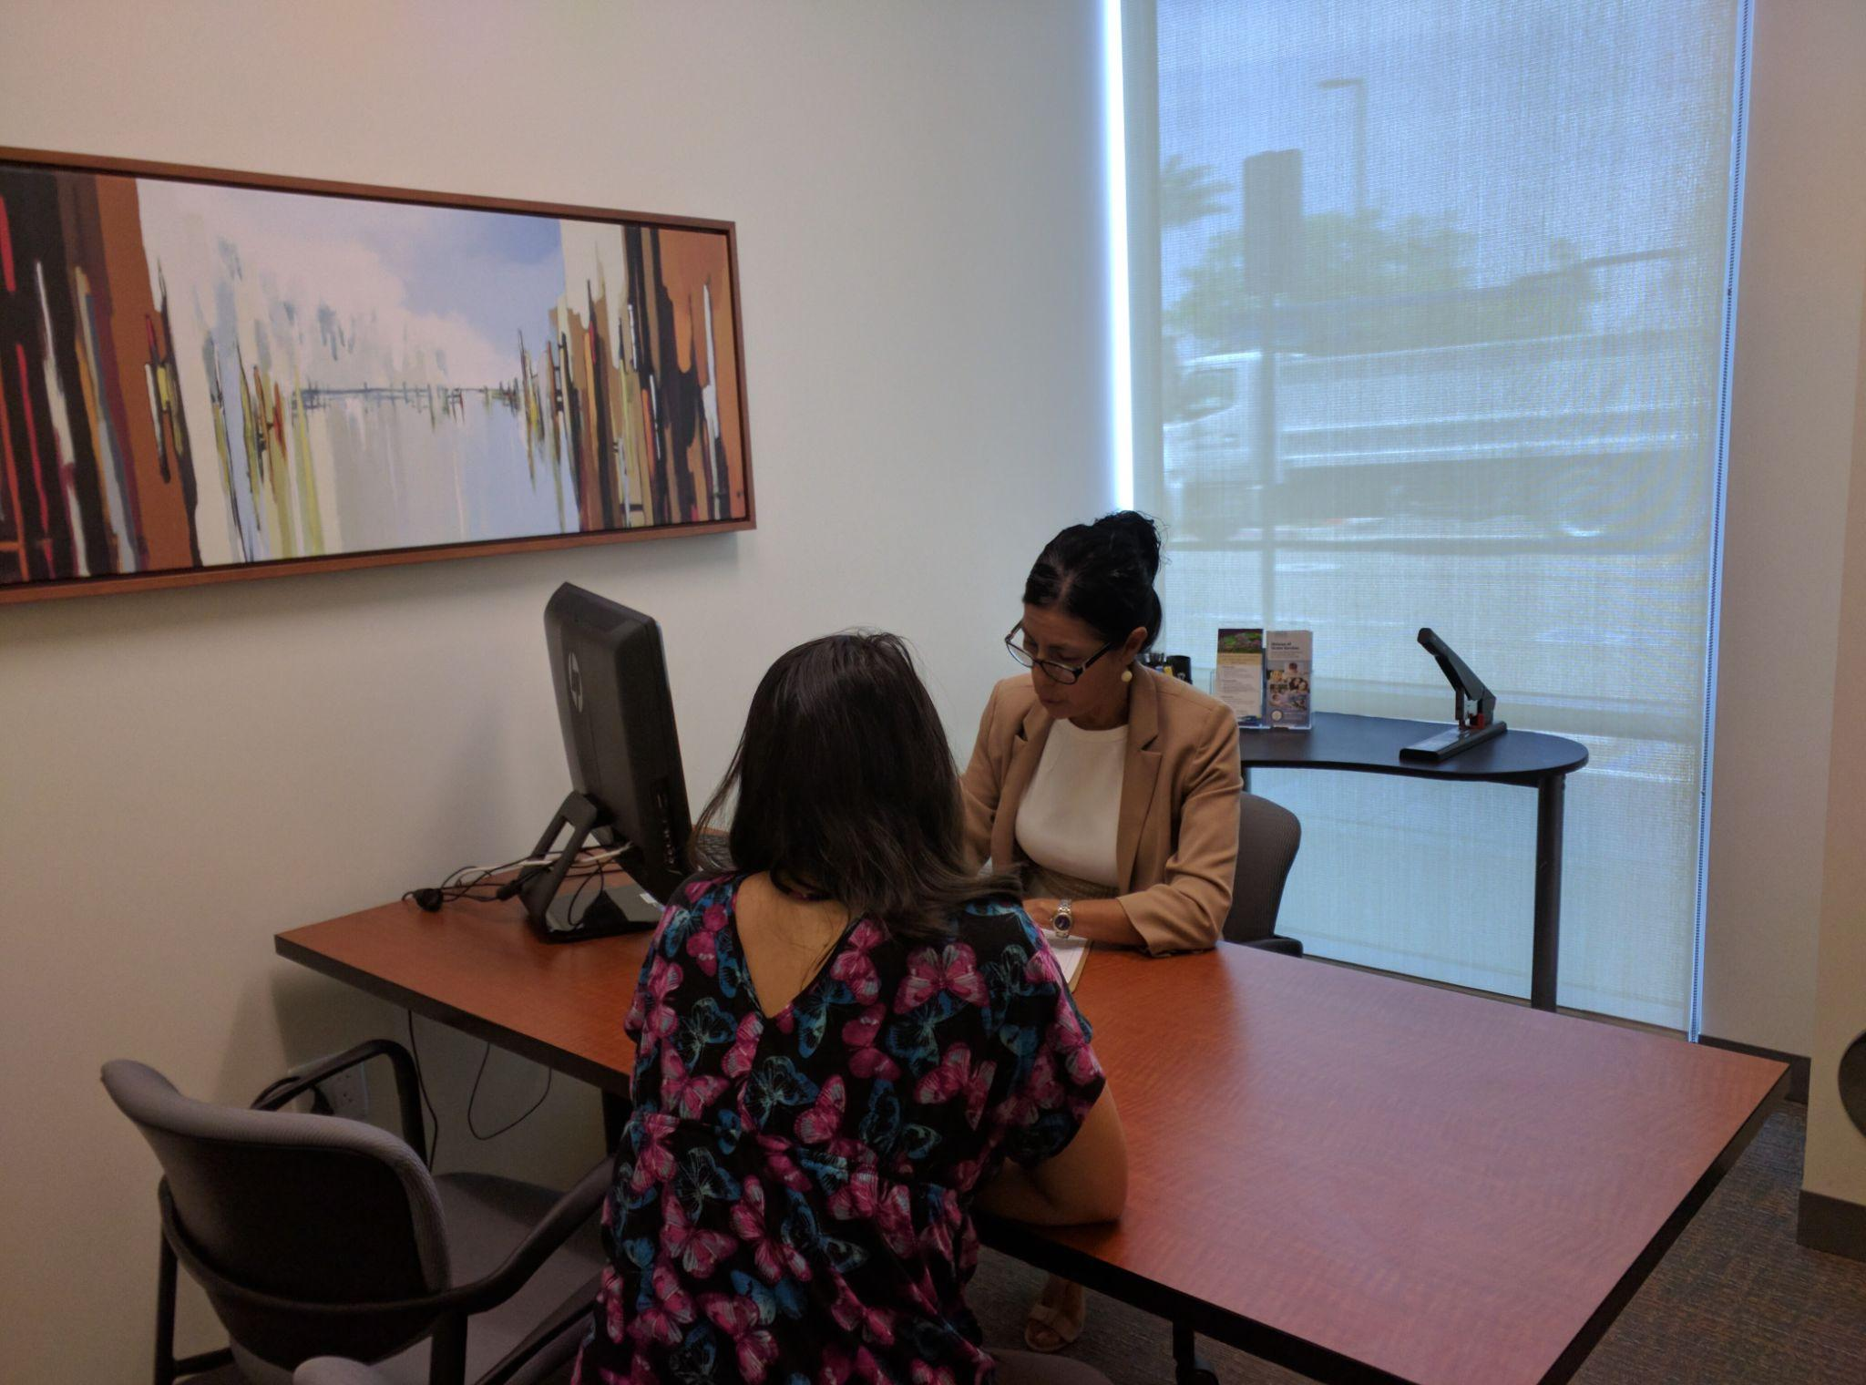
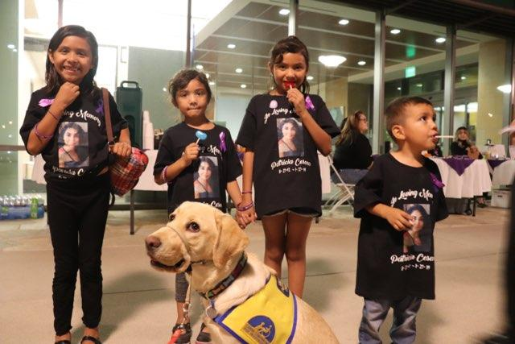
Riverside County FJC

Slide 42

Your Safe Place - City of San Diego

Slide 43
Hope Lives Here

Slide 44
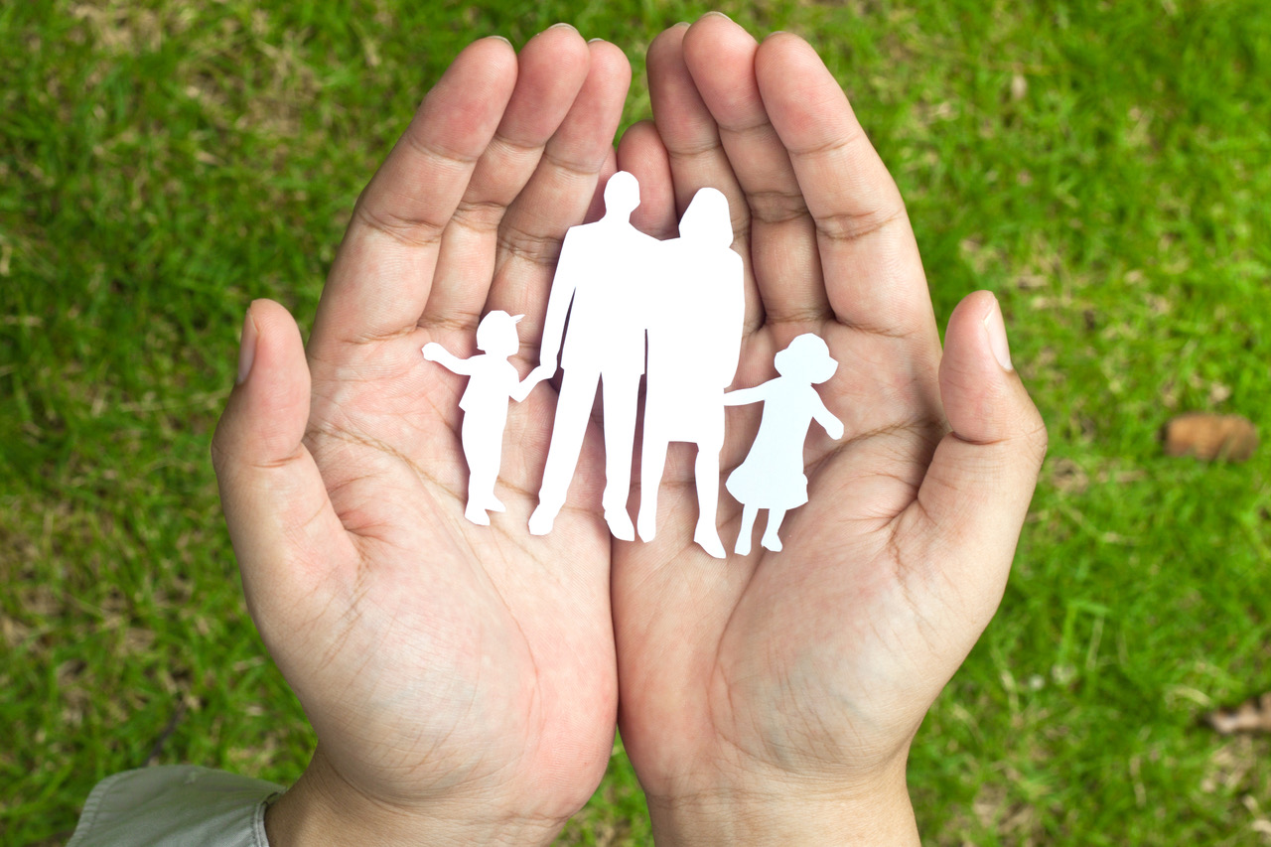
Safe Families Create Safe Communities
#CFJNAdvocacyDay

